Slide 1
Project Professional 2016
Hari Thapliyal

Slide 2
Backstage

Slide 3
What is Backstage?

Slide 4
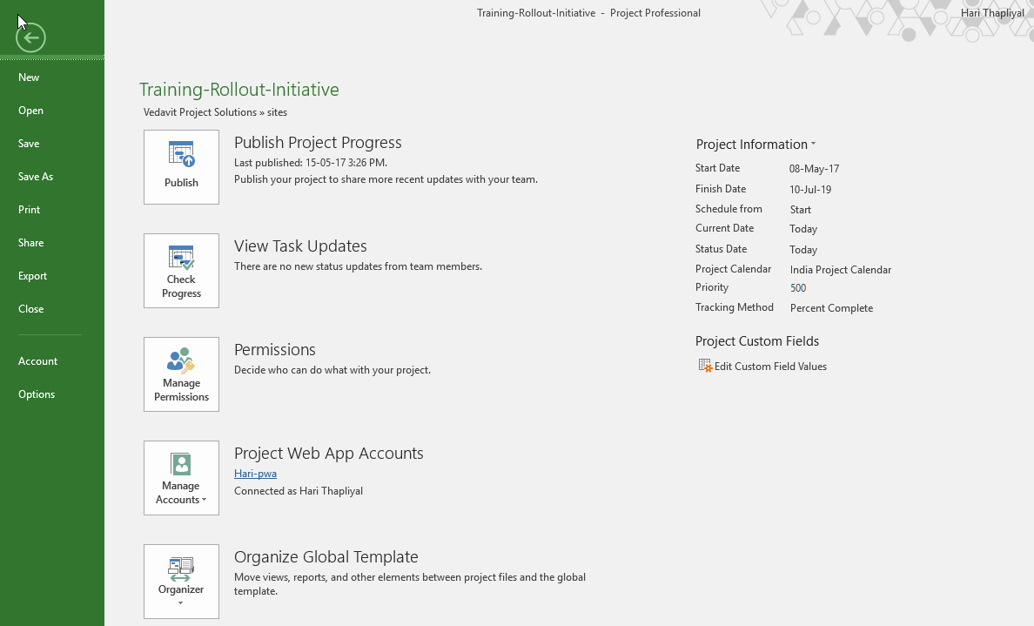
Backstage – Location in Tool

Slide 5
Backstage – How to Create PWA Account

Slide 6
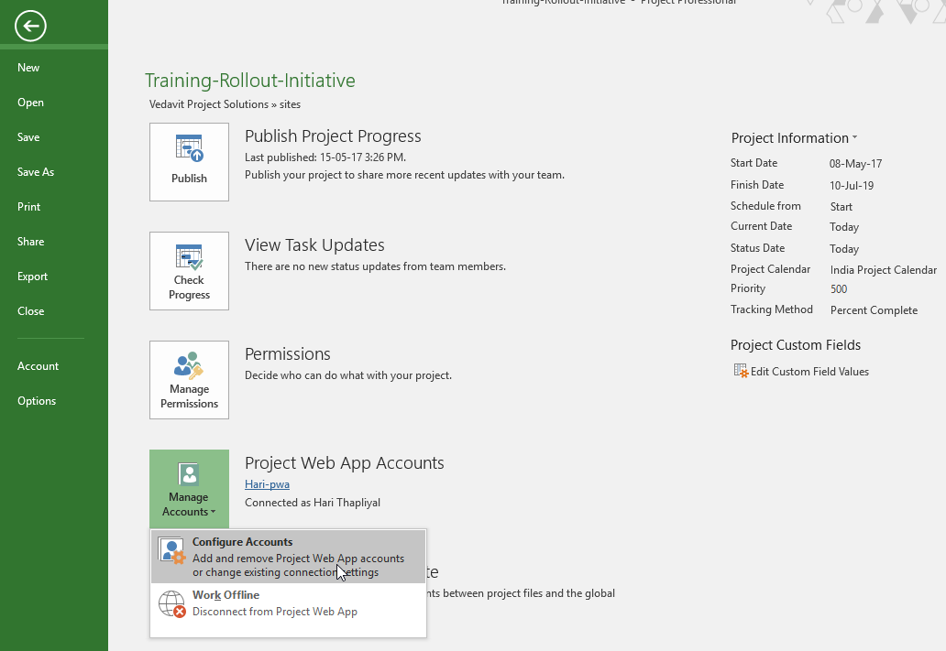
Manage Account

Slide 7
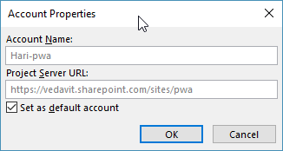
Create a Connection to PWA from Project Professional 2016 (Installed on Location Machine)

Slide 8
Publish Project on Project Server 2016 or Project Online

Slide 9
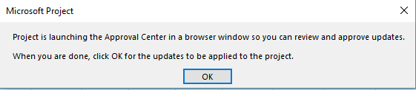
Project Professional 2016 : How to Updates Actuals in Project?

Slide 10
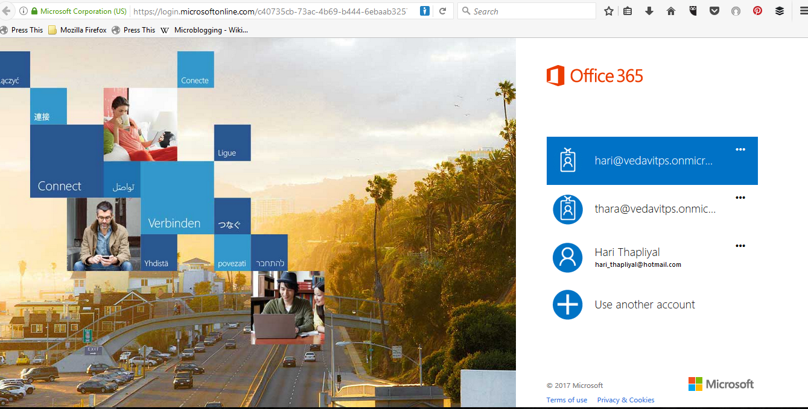
May need to login into Office365 Account (if not logged in)

Slide 11
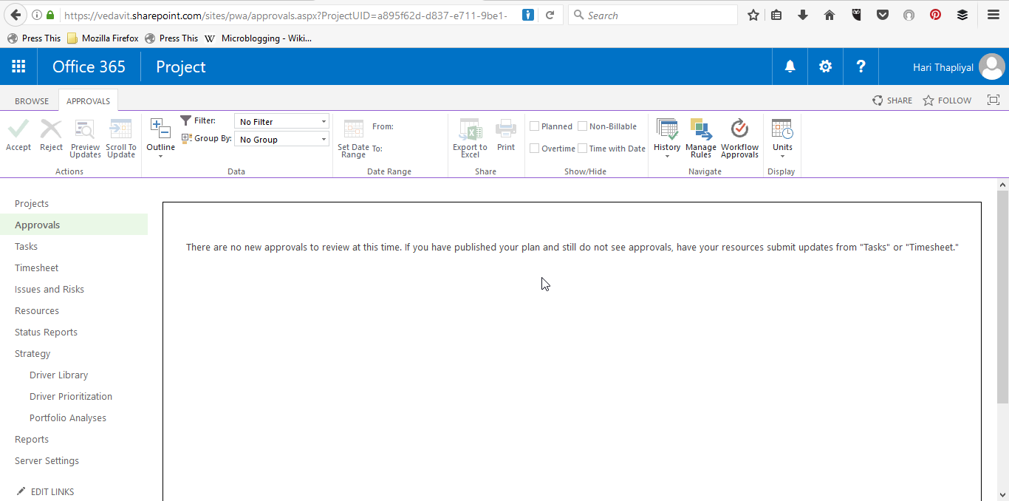
List of Tasks for which status is submitted by the Team
1
2

Slide 12
Organizer

Slide 13
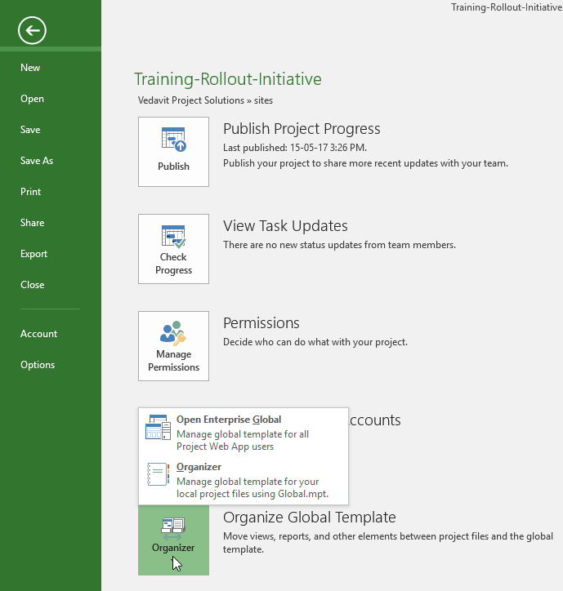
Organizer – Location in Tool

Slide 14
Usage of Organizer

Slide 15
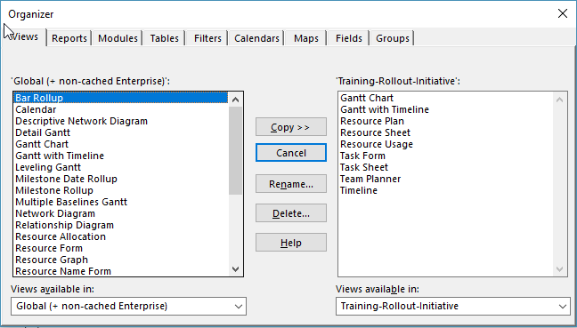
Organizer

Slide 16
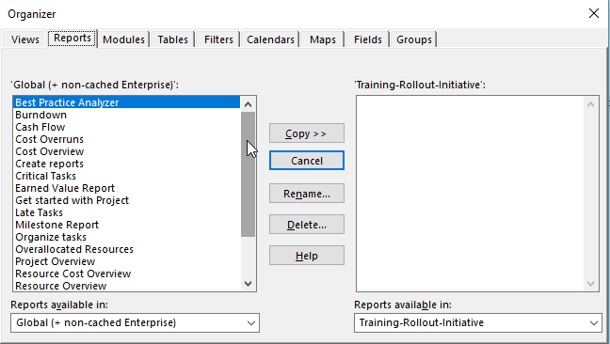
Project Professional - Training-Rollout-Initiative

Slide 17
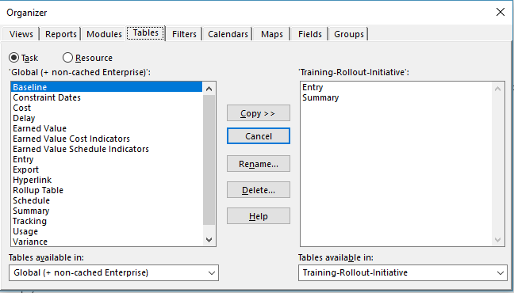
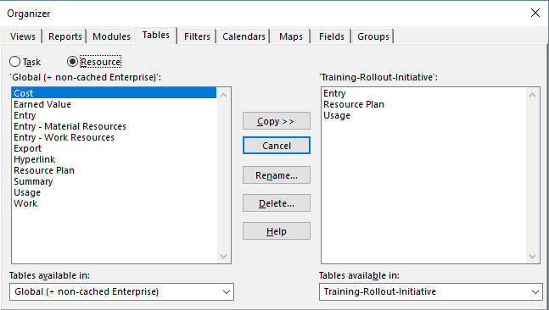
Organizer - Tables

Slide 18
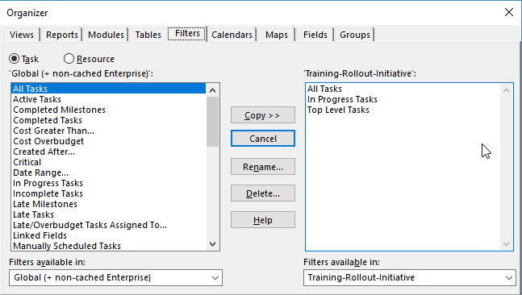
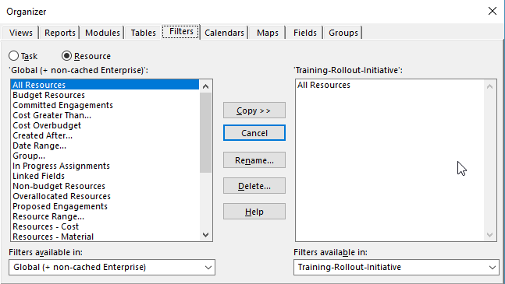
Organizer

Slide 19
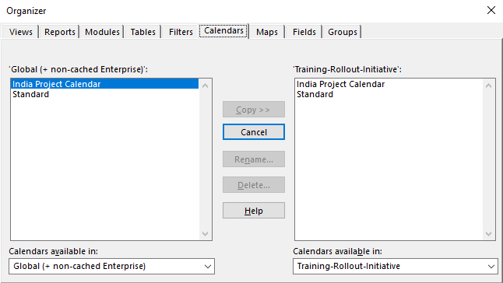
Organizer

Slide 20
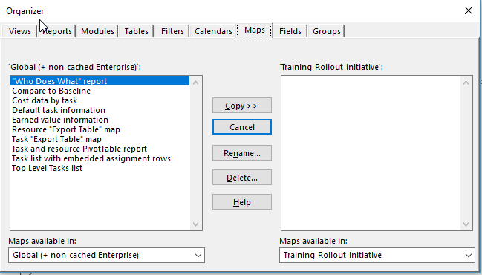
Project Professional - Training-Rollout-Initiative

Slide 21
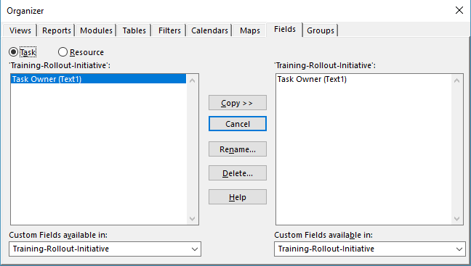

Organizer - Fields

Slide 22
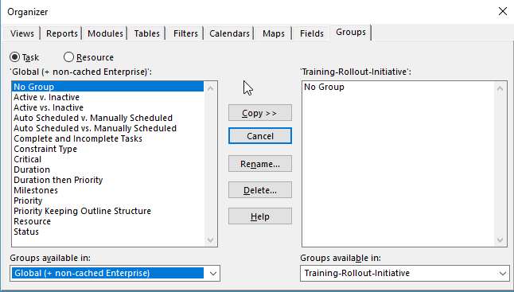
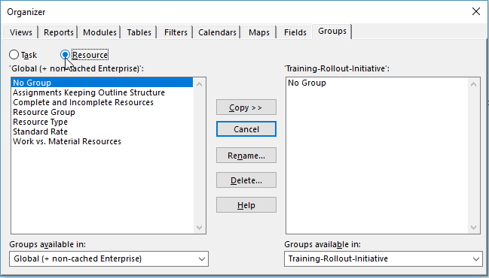
Organizer - Group

